Slide 1
Volunteer Services
Annual Refresher 3/22

Slide 2
Our mission statement….
We,
Trinity Health, serve together in the
spirit of the Gospel as a compassionate
and transforming healing presence
within our communities.

Slide 3

How do you live our mission in your volunteer role?
By moving with intention and applying our “Core Values”.

Slide 4

St. Joe’s Core Values
Reverence
Justice
Commitment to Those Who are Poor
Stewardship
Integrity

Slide 5
CORE VALUES……
Commitment To Those Who Are Poor: We stand with and serve those who are poor, especially those most vulnerable.
Move to help those in need and provide comfort.
Stewardship: We honor and hold ourselves accountable for the human, financial, and natural resources entrusted to our care.
Move with an owner’s mind and servant’s heart.
Safety: We embrace a culture that prevents harm and nurtures a healing, safe environment for all. Move safely in all of your tasks.

Slide 6
CORE VALUES…….
Reverence: We honor the sacredness and dignity of every person.
Move to connect with compassion and courtesy.
Integrity: We are faithful to who we say we are.
Move with gratitude.
Justice: We foster right relationships to promote the common good, including sustainability of earth.
Move to maintain healthy and trusting relationships.

Slide 7




Core Value Highlight:
3 Essential “Safety” Practices

Slide 8

Daily Safety Measures
Health Screening & PPE Required
You must wear an approved mask
at all times while on a St. Joe’s campus..
If you have any of the following symptoms or been exposed :
PLEASE STAY HOME and consult your physician for next best practices.
If you have fever, chills, cough, shortness of breath, or difficulty breathing. Sore throat, loss of smell or taste, headache, runny nose, muscle aches/pain, diarrhea, nausea or vomiting.
You MUST past an in-person screening
prior to access on campus.

Slide 9

The Patient Experience
Our mission as volunteers is to provide comfort measures
to the patients and visitors.
While we support the St. Joe’s colleagues, we are not permitted
to perform the task in which they are employed to do for the patients.
Therefore, we understand our role is to add that extra care and support making the
visit here ReMarkable.
Patients are at the center of all we do… Let’s review ways of connecting with them.

Slide 10



We MUST show and connect with……..
M2: Relating to Our Patients
“To sense the client’s private world as if it were your own, but without ever losing the “as if” quality – this is empathy,” Carl R. Rogers, Culture of Empathy Builder
Notes:
<1 minute
But we ask ourselves, are good listening skills enough? What else can we do to better relate to our patients?
So we are faced with this conundrum:
We were trained to “fix”, which is the logic part of the brain.
When we can’t “fix”, then what?
Start with complete acceptance of the present state.
Listen, and empathize first ---- fix later.
Remind yourself that empathy is thinking AND feeling.
Review slide.
Source:
Image: Cleveland Clinic Empathy Course attended by Dr Kevin Taylor
Timing: <1 minute
Participant Workbook: n/a
KEY POINTS:
LISTEN and empathize first, fix later.
Module 2: Relating to Our Patients

Slide 11
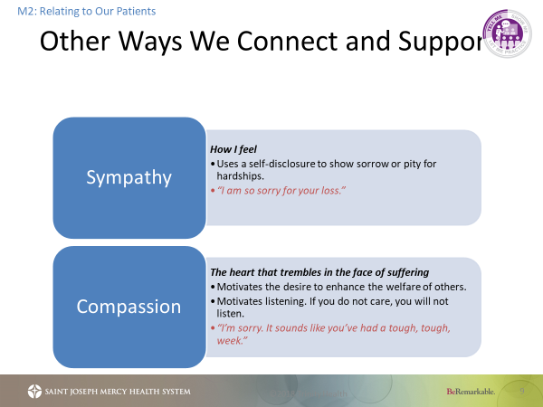
Here are some examples of speaking that shows we care about our patients.

Slide 12

Speaking and Listening are equally important.
Now, let’s review ways to listen so we best understand how words can heal and help.
Y

Slide 13
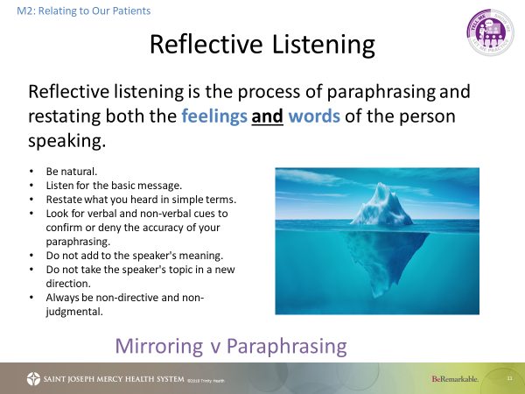

Slide 14
Active Listening
M2: Relating to Our Patients
Active listening is the best way to connect with another person and is a vital piece of any healthy relationship.
Verbal
Positive Reinforcement
Remembering
Non-Verbal
Eye contact
Smile
Head nod
Posture
Focus
Mirroring
Questioning
Clarification
Reflection
Notes:
2 minutes
SAY:
Active listening involves listening with all senses. As well as giving full attention to the person speaking – being In the Moment - it is important that the ‘active listener’ is also ‘seen’ to be listening - otherwise the speaker may conclude that what they are talking about is uninteresting to the listener.
Interest can be conveyed to the speaker by using both verbal and non-verbal messages.
By providing this 'feedback' the person speaking will usually feel more at ease and therefore communicate more easily, openly and honestly.
Timing: 2 minutes
Participant Workbook: n/a
KEY POINTS:
Active Listening involves listening with all senses.
Module 2: Relating to Our Patients

Slide 15
Customer Service &
Service Excellence Standards

Slide 16
Customer Service
We Respect Differences
We Respect Privacy
We Strive for Excellence in All We Do
We Take Responsibility for Our Customer Needs
We View a Customer Complaint as a Gift
We Take Pride in Cleanliness
.
We Are Honest and Ethical

Slide 17
Empathy

Slide 18
Service Excellence Standards
Welcoming Environment & Teamwork
Attitude/Courtesy/Respect
Elevator Courtesy
Communication:
Greetings & Phone Call Etiquette
Responsiveness & Wait Time,
Personal Appearance,
&
Environmental
AIDET
&
A4 Approach
Managing Up & Wayfinding
.
Confidentiality & Privacy

Slide 19
How to Interact With Patients using Customer Service
A | I | D | E | T
Acknowledge | Introduce | Duration | Explanation | Thank You
Smile at least once during every encounter. | “Hi my name is [name] and I am a volunteer, how can I help you? | How long will it take the visitor to get to their destination? | Know the hospital well, and help visitors as much as possible. | Ask visitors if you’ve answered all of their questions before they leave you.

Slide 20
Wheelchair Transportation

Slide 21
Wheelchair 101:
STEP #1
Always introduce yourself and be friendly, cooperative and cheerful.
STEP #2
When assisting a patient in or out of a wheelchair be sure to set the brakes.
  STEP #3
  See that the patient's arms are inside the armrests, not hanging over the side.
Caution Wheel Chair Tips:
Remember to do a wheelchair roundup where applicable.
Never block aisles or exits - even temporarily.
STEP #4
Ask the patient if s/he is ready before moving and explain where you are going.

Slide 22
Traveling to Your Destination/When You Get There
STEP #1
Push the wheelchair slowly, approach corners and doorways cautiously using overhead mirrors.
STEP #2
At the elevator be sure the floor is level before proceeding. Always back a wheelchair onto the elevator so the patient is facing forward when exiting.
  STEP #3
  Avoid short, quick stops, which tend to throw the patient forward.
.
  STEP #4
  Stay with the patient until staff is able to assist them; never leave a patient unattended.
STEP #5
Never lift a patient out of a wheelchair - call a nurse to move the patient.
Caution Chair Tips:
Return wheelchair to the area you borrowed it from.

Slide 23
Infection Control

Slide 24
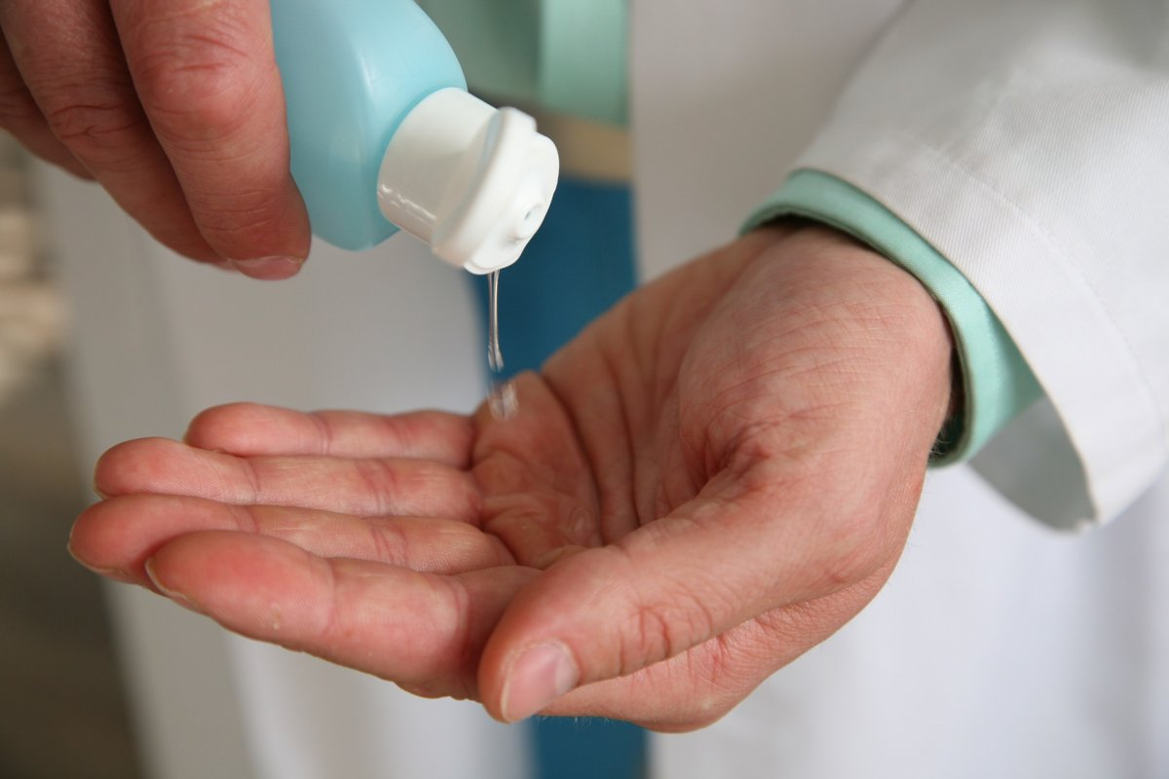
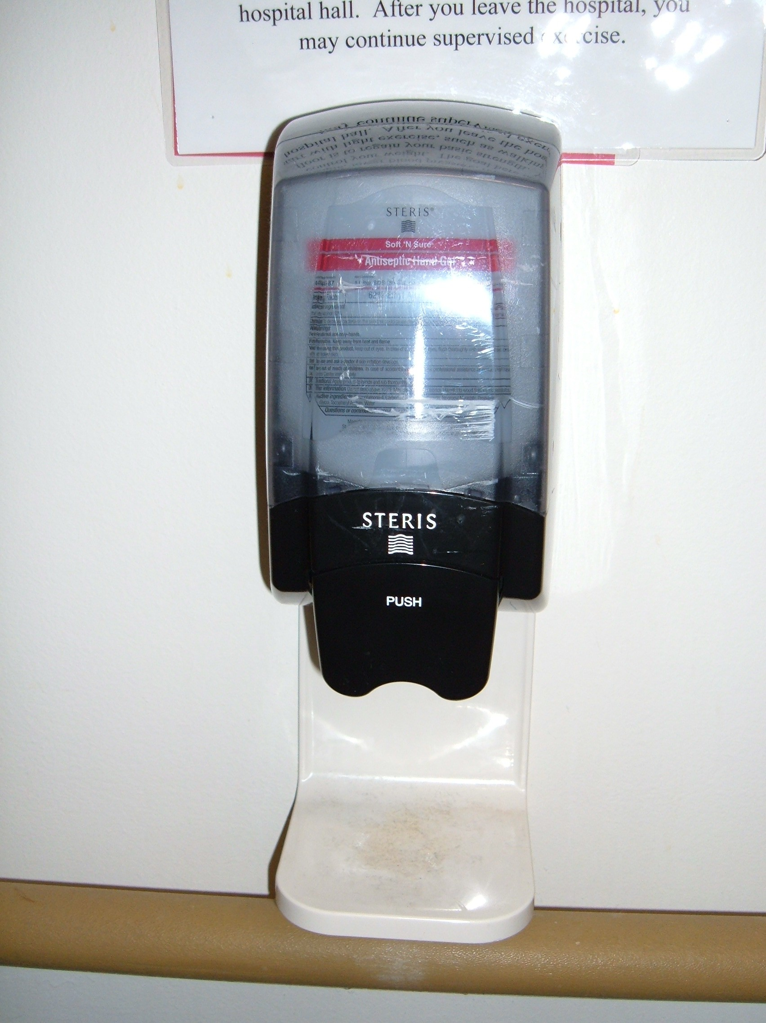
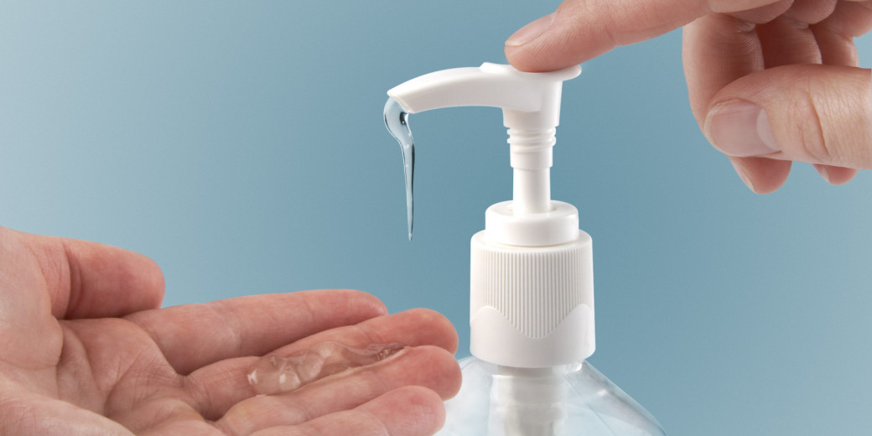
Please have visitors use hand sanitizers.
Make sure you keep some available at your station.

Slide 25

The Basics
Hand washing and gel sanitizing is the single most effective way to prevent the spread of infection
Avoiding contact with blood and other body fluids of patients is a standard precaution
Volunteers are not expected to interact with patients who are in isolation. If you have any questions, please contact your liaison.

Slide 26
Handwashing Technique
Moisten hands under warm running water
Rinse with running water.
Dry hands thoroughly with paper towel or under a hand dryer.
Apply soap to wet hands. Work up a lather and lather for 15-30 seconds.

Slide 27
Absence Policy

Slide 28
Absence Policies
Illness
  If you are NOT feeling well, you should stay home and contact your liaison to let them know you will not be able to make it to your shift.
Scheduled Absence
  If you are unable to make a shift you should let your liaison know ahead of time
Accident
  Report to your liaison immediately

Slide 29
Confidentiality/HIPPA

Slide 30
Confidentiality/HIPPA Policies
Verbal discussions relating to specific patients, patient care and/or location must be held in a manner that protects the patient’s confidentiality.
Treat all personal information that patients tell you as confidential.
Confidentiality
Do not ask about the diagnosis or facts of a case.
Never read a patient's medical chart.

Slide 31
Hospital Emergency Codes are changing to overhead announcements Effective
July 1, 2018

Slide 32
Emergency Codes ARE Plain Language Alerts
*
Yellow
There is an internal or external disaster
Statement: We are responding to a disaster.
Blue
Cardiac/Respiratory Arrest
Still called overhead the same .
Red
Fire/Smoke Emergency
Statement: There is a fire alarm activation at…..
White
Workplace Violence/Security Needed
Statement :Security assistance is required…..
Pink/Amber/Teal
Infant/Child or PersonMissing or Abducted
Statement: There is a missing baby described as (age, gender) last seen wearing…..or person …
Green
Medical Emergency (not in cardiac/ respiratory arrest)
Statement: There is a Medical Emergency on floor……

Slide 33
Other Emergencies Without a Code
Tornado Watch/Warning
Code Black
Statement:
There is a tornado/thunderstorm in effect until…..
Bomb Threat
Information of an explosive device has been received.
Active Shooter/Code Silver
Includes frequent updates
There is someone in the hospital with a firearm who is using it to kill, or in an attempt to kill persons within the hospital.
**Note: these emergencies will be announced directly.**

Slide 34
Domestic Violence
Definition:
We define domestic violence as a pattern of abusive behavior in any relationship that is used by one partner to gain or maintain power and control over another intimate partner. Domestic violence can be physical, sexual, emotional, economic, or psychological actions or threats of actions that influence another person. This includes any behaviors that intimidate, manipulate, humiliate, isolate, frighten, terrorize, coerce, threaten, blame, hurt, injure, or wound someone.
Our Policy:
If a volunteer learns of a situation that may indicate that a patient is a current victim of domestic violence, bring the information directly to the healthcare provider responsible for the patient. It will be their responsibility to further assess and refer according to our policy.

Slide 35
Kiosks & Dress Code

Slide 36
Hospital Kiosks
You are required to swipe in and out on the day you volunteer. This is necessary for our monthly reports, your awards, and allows you to be covered by our liability insurance.
Volunteer kiosks are located in the following locations:
      SJMH Front Desk, RHB Info Desk, Family Birth Center / Imaging Center hallway, Women’s Health Center 2nd floor Information Desk, SJMH Livingston, SJMH Brighton
Volunteers working in other off-site locations sign in where they work. Sign-in logs will be faxed on a monthly basis to (734)712-7178. When you come to volunteer, and your sheet is gone, you will need to start a new one.

Slide 37
Dress Code
Volunteers MUST wear their volunteer jacket and I.D. badge while on duty.
No excessive jewelry.
No visible body piercings other than earrings.
.
Wear closed-toe shoes with hosiery.
  Be conservative in hair, dress and make up, with long hair tied back.
Use fragrance-free personal products.
No Denim, Capri pants, leggings, sweatpants or shorts. No bare legs!

Slide 38
Thank you for your service!
Please return to the website Resources Center and submit your volunteer annual refresher acknowledgement form.

