Slide 1
Annual Refresher
Volunteer Services
Lisa N. Austin
Manager, Volunteer Services

Slide 2

ONLY VIEW THIS POWER POINT IF………
YOU ARE A RETURNING VOLUNTEER AFTER SERVING NO LONGER THAN 1 YEAR AGO.
OR…..
IF YOU ARE ACTIVELY VOLUNTEERING AND HAVE REACHED YOUR 1 YEAR ANNIVERSARY DATE.

Slide 3
Trinity Health Mission Statement
We,
Trinity Health, serve together in the spirit of the Gospel as a compassionate and transforming healing presence within our communities.

Slide 4


Volunteer Services Mission Statement
We add comfort, support, and security measures to the Trinity-Health patient experience.
Our goal in volunteering is to support the overall Trinity-Health mission of being a healing presence.
Volunteers a “Gift” to our Community

Slide 5
How do you live our mission in your volunteer role?
By moving with intention and applying our “Core Values” of……..
Reverence
Justice
Integrity
Safety
Stewardship
Commitment to those that are experiencing poverty

Slide 6
Volunteers in movement……Core Values
Commitment To Those Who Are Experiencing Poverty: We stand with and serve those who are poor, especially those most vulnerable.
Move to help those in need and provide comfort.
Stewardship: We honor and hold ourselves accountable for the human, financial, and natural resources entrusted to our care.
Move with an owner’s mind and servant’s heart.
Safety: We embrace a culture that prevents harm and nurtures a healing, safe environment for all. Move safely in all of your tasks.

Slide 7
Volunteers in movement……Core Values
Reverence: We honor the sacredness and dignity of every person.
Move to connect with compassion and courtesy.
Integrity: We are faithful to who we say we are.
Move with gratitude.
Justice: We foster right relationships to promote the common good, including sustainability of earth.
Move to maintain healthy and trusting relationships.

Slide 8
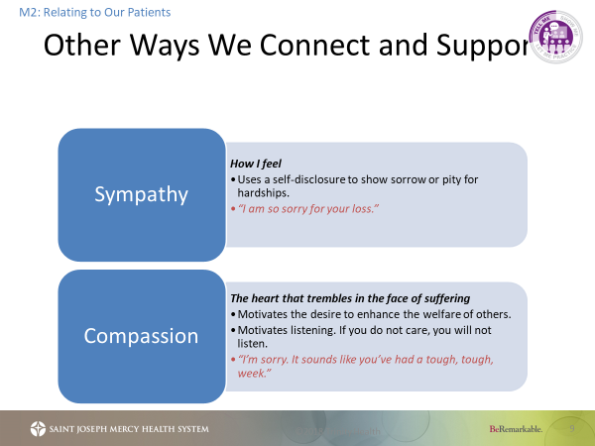
Here are some examples of speaking that shows we care about our patients.

Slide 9

Speaking and Listening are equally important.
Now, let’s review ways to listen so we best understand how words can heal and help.
Y

Slide 10
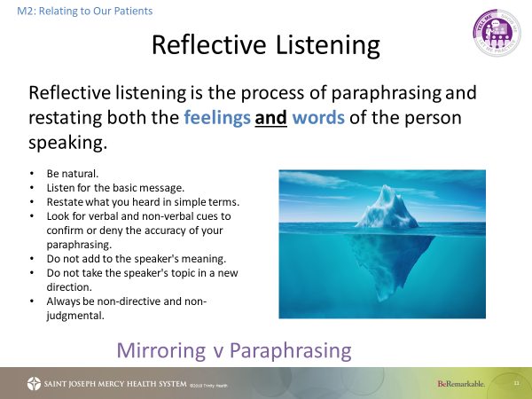

Slide 11

Active Listening
M2: Relating to Our Patients
Active listening is the best way to connect with another person and is a vital piece of any healthy relationship.
Verbal
Positive Reinforcement
Remembering
Non-Verbal
Eye contact
Smile
Head nod
Posture
Focus
Mirroring
Questioning
Clarification
Reflection
Notes:
2 minutes
SAY:
Active listening involves listening with all senses. As well as giving full attention to the person speaking – being In the Moment - it is important that the ‘active listener’ is also ‘seen’ to be listening - otherwise the speaker may conclude that what they are talking about is uninteresting to the listener.
Interest can be conveyed to the speaker by using both verbal and non-verbal messages.
By providing this 'feedback' the person speaking will usually feel more at ease and therefore communicate more easily, openly and honestly.
Timing: 2 minutes
Participant Workbook: n/a
KEY POINTS:
Active Listening involves listening with all senses.
Module 2: Relating to Our Patients

Slide 12

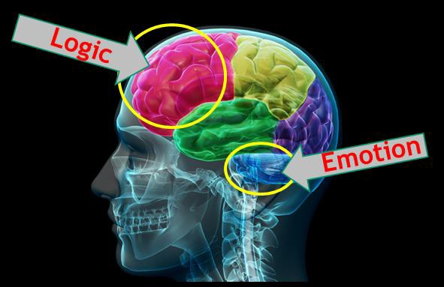
hn……..
M2: Relating to Our Patients
COMFORT, SUPPORT, & SECURITY MEASURES REQUIRE…..
“To sense the client’s private world as if it were your own, but without ever losing the “as if” quality – this is empathy,” Carl R. Rogers, Culture of Empathy Builder
Notes:
<1 minute
But we ask ourselves, are good listening skills enough? What else can we do to better relate to our patients?
So we are faced with this conundrum:
We were trained to “fix”, which is the logic part of the brain.
When we can’t “fix”, then what?
Start with complete acceptance of the present state.
Listen, and empathize first ---- fix later.
Remind yourself that empathy is thinking AND feeling.
Review slide.
Source:
Image: Cleveland Clinic Empathy Course attended by Dr Kevin Taylor
Timing: <1 minute
Participant Workbook: n/a
KEY POINTS:
LISTEN and empathize first, fix later.
Module 2: Relating to Our Patients

Slide 13
Managing Up vs. Managing Down
You are in good hands
He is my doctor too
She is one of our top cardiologist.
We are short staffed
They never tell us anything
That’s Our Policy
We have always done it that way
That is not my job.
YOUR TURN……AT THE DOOR ACTIVITY. (AA MAP)

Slide 14
Service Excellence Standards
Commitment to each other.
Welcoming Environment & Teamwork
We value each other as individuals.
We are on time, prepared and begin and end meetings promptly.
We are empowered to own and solve problems.
We seek to learn and are open to new ideas & change.
We ask for, welcome and give feedback to each other in a timely, direct and constructive manner.
We act with honesty and integrity, taking responsibility for our actions.

Slide 15
Service Excellence Standards
Positive Impressions:
Environmental
We promote a quiet environment
We always clean our hands before and after contact with a patient , equipment, and their environment.
We create a safe workspace and “speak up: whenever we have a safety concern

Slide 16
Service Excellence Standards
Positive Impressions:
Environmental
We take ownership for keeping our environment clean.
We eat and drink in designated places.
We put equipment away and store it properly.

Slide 17
Service Excellence Standards:
We respect privacy
We respect differences
We are honest and ethical
We strive for excellence in all we do
We take responsibility for our customer’s needs
We view a complaint as a gift

Slide 18
Service Excellence Standard: A4 Approach
  The A4 approach is a model to handle customer complaints.
  Acknowledge the situation-
  I can see how this has been difficult Mr. Smith.
  Apologize for the situation-
  I am so sorry that you have not had a good experience.”
  Ask:
  How can we make this situation better for you?
  Act:
  This is what I will / can do. Are you comfortable with this?
  Then set follow-up expectations.

Slide 19
Service Excellence: Communication Standards
ICARE
  Managing Up is a form of communication that positions information, a person, or team in a positive manner. Take the opportunity to speak positively of other providers, nursing, team members, volunteers, a department or the organization.
Positioning information in a positive manner:
Reduces anxiety and concerns, Improves perception of care, Wins confidence, Improves compliance, Improves teamwork, Reduces complaints, Improves outcomes.
  Now let’s learn about ICARE a step-by-step format to speak to customers in a concise manner……

Slide 20
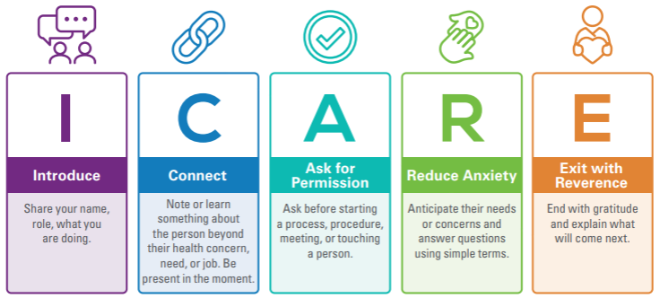
Because “I-CARE”, I Commit to…..
Notes:
Version:

Slide 21
ICARE
INTRODUCTION | …is an establishment of trust by using welcoming words, friendly gestures, creating familiarity, and showing a desire to help.
CONNECT | …is a focus on our shared humanity, curiosity, and compassion. Connection is providing a space where people can feel like they are a part of something big together, not “us vs. Them” - A partnership.
ASK FOR PERMISSION | …is a minute-by-minute inclusion practice that empowers and encourages those we are communicating with to be fully aware, involved, and present in the interaction.
REDUCE ANXIETY | …is a constant and conscious choice to interact with others in a way that reduces feelings of tension, worried thoughts – compassionately cheering up, or calming down, those around us. Building confidence.
EXIT WITH REVERENCE | …is re-creating a meaningful connection as the interaction draws to a close through sacred acts like respect, humility, empathy, and kindness.
Notes:
3-4 minutes
Introduction
Trinity Health’s Ministry Leadership Council, made up of our regional CEOs and Executive Leadership Team at the system level, have approved ICARE as Trinity Health’s service standards for these reasons:
Evidence based model; implemented internally and externally with proven results
Simple, easy to remember
Incorporates what matters most:
Basic courtesy, respect and empathy
Communication – clarity, listening
Partnering/engaging with patient
Establishes a long-term framework, providing foundation for full care experience program.
Creates and reinforces consistent expectations
Applies to all settings and all people (patients, clients, residents and colleagues)
Addresses Likelihood to Recommend key drivers and is aligned with Our Trinity Health Culture.
This is our WHY – WHY ICARE
Say:
ICARE is…a Relational Model with a patient experience approach that is recommended to more positively and effectively communicate with everyone we touch, patients and each other.
Each component of ICARE represents an opportunity for us to connect each action to each human to human interaction.
Review each component and WHY each one is important.

Slide 22
Health Insurance Portability and Accountability Act (1996).
Patient Rights & Responsibility

Slide 23
HIPAA & PRIVACY
The Privacy Rule of the Health Insurance Portability and Accountability Act of 1996 (HIPAA) establishes national standards to protect individuals’ medical records and other personal health information.
The HIPAA Privacy Rule also gives individuals rights over their health information, like getting a copy of their records and seeking correction.
The Rule applies to 3 types of HIPAA covered entities, like health plans, health care clearinghouses, and health care providers that conduct certain health care transactions electronically to safeguard protected health information (PHI) entrusted to them.

Slide 24
Confidentiality and HIPAA
Treat all information patients share as confidential.
Do not ask about diagnosis or treatment plans.
Never read a patient’s medical chart.
All verbal discussions related to a patient's care should not be discussed in public areas.

Slide 25
Patient Rights & Responsibilities
Key Patient Rights
Respect and Dignity: To receive care without discrimination regarding age, race, religion, gender, or disability.
Information and Consent: To receive complete, clear information about diagnosis, treatment, and prognosis to make informed decisions.
Privacy and Confidentiality: To have medical records kept confidential and to experience privacy during examinations.
Participation in Care: To be involved in developing their treatment plan and to make decisions about their care.
Refusal of Treatment: To refuse treatment to the extent allowed by law and be informed of the consequences.
Access to Records: To review and obtain copies of their medical records.
Safety: To be free from unnecessary restraint, seclusion, or abuse.

Slide 26
Infection Control:

Slide 27
Hand washing is the single most effective way to prevent the spread of infection.
Hands must be washed:
On arrival to volunteer
Before leaving the restroom
Before and after eating
After removing gloves
Between handling of patients
After using the toilet, after blowing or wiping the nose
Before leaving the hospital

Slide 28
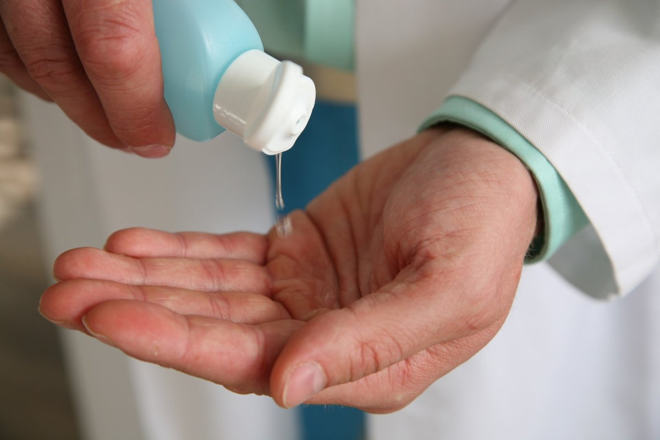
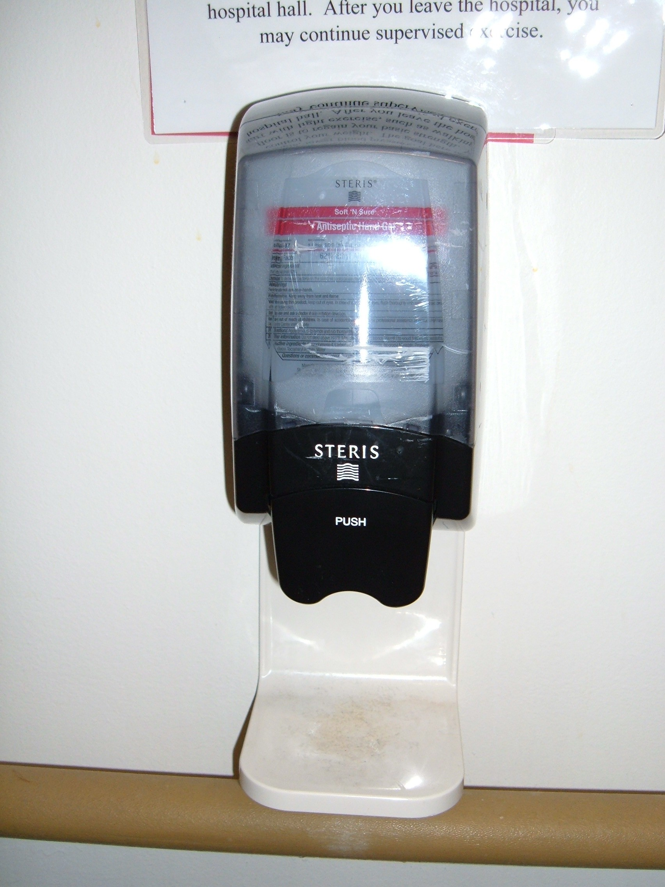
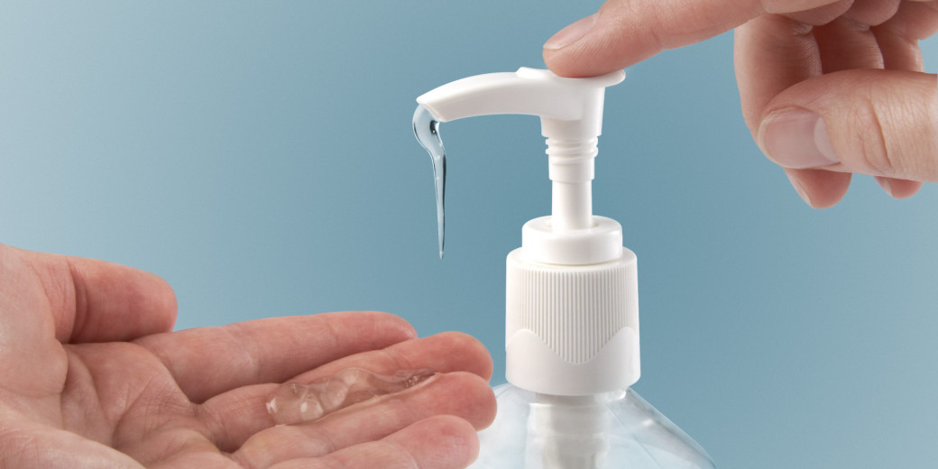
Make sure you keep some available at your station.

Slide 29
Plain Language Review & Safety

Slide 30
Plain Language
Hospitals use plain language for emergencies
The only color code is CODE BLUE
Event | Overhead Announcement "Your attention please..."
Disaster | "[Ministry] is responding to a(n) [specific] disaster. More information to follow."
Fire Alarm | "There is a fire alarm activation in[floor/unit/department]"
Code Blue | "There is a Code Blue in [floor/unit]"
Medical Emergency | "There is a medical emergency on [floor/unit/dept]"
Rapid Response | "There is a rapid response needed in [floor/unit]"
Severe Weather Event | "There is a [severe weather event] [watch/warning] in effect until [time]"
Missing infant or child and description | "There is a missing [child/infant]. [Description]"
Missing patient and description | "There is a missing patient. [Description]."
Security assistance required and location | "Security assistance is required in [location]"
Active Shooter and location | "There is an active shooter in [location]"

Slide 31
What to do in a Fire Alarm Activation
At Fire Scene, use R.A.C.E. to guide your actions:
  Rescue
  Alarm
  Close doors
  Extinguish / Evacuate
Also be sure to:
  Reassure patients
  Close doors
  Clear hallways

Slide 32
In a Fire Alarm Activation
DO NOT use elevators
MOVE EQUIPMENT on wheels in the hallways to one side (or to alcoves)
Make sure exits, extinguishers, and fire pull stations are not blocked
Remember: Never store items above 18’’ from the sprinkler head or below ceilings in rooms without sprinklers

Slide 33
Wheelchair 101: Transporting Procedure
Due to liability, you may not physically assist a person into a wheelchair.
If you push a wheelchair to a person, lock the brakes and allow a family member to assist them into the chair.
Do not go outside to a vehicle to help a person into a wheelchair.
Ask for help from a colleague or call security at 2-3344

Slide 34
Attendance/Absence

Slide 35
Volunteer Procedures/ Check-In
You are required to swipe in and out everyday you volunteer. This is necessary for you to be covered by our liability insurance, to record your volunteer hours, and lastly consideration for service awards.
All volunteers should present in a happy and healthy manner prepared to serve in the role they are trained. Making a difference begins with you. Our patients, families , and visitors rely on your kindness and compassion to assist them through the health care journey.

Slide 36

Volunteer Procedures Check in/Check out
Volunteer kiosks are located in the following locations at our hospitals.
Trinity Health Ann Arbor, Chelsea, & Livingston Front Desk/lobby area, Reichert Health Building info desk, Imaging Center hallway, & Ann Arbor emergency department discharge area. Canton & Brighton Health Centers main information desks upon entry.
Refer to your orientation packet on swiping in procedures for Vsys One.
Swipe in using the swiper if available.
Use the mouse to enter your volunteer ID number, located on the back of your badge if there is no swiper.
If the screen is changed, return-back to Zenworks to open-up our program and/or hit the windows button.
VSYS
ONE
KIOSK

Slide 37
Volunteer Procedures: Your Volunteer Liaison
Main contact person for the unit or dept. where you are assigned.
The person in charge of you and responsible for your specific orientation and training(although you may report weekly to other staff).
Please inform your liaison when you will be out of town, sick, or decide to discontinue volunteering.
Illness: If you are not feeling well, you should stay home and contact your liaison to let them know you will not be in on that day.
Attendance: Be punctual and regular in attendance but if you are unable to make a shift you should let your liaison know ahead of time. Meet commitment 4 hour &/or 6 -month annual serving requirement.
Accident on Duty: If you witness an accident or are injured yourself report to your department liaison immediately. An incident report will need to be completed.

Slide 38
Volunteer Procedures Dress Code Do’s & Don’ts
Do: Always do the following related to dress code and volunteer policy and expectations.
Wear your name badge and volunteer Trinity blue vest at all times when volunteering.
Don’t: Present for volunteering with any of the following.
No Jeans, capri pants, leggings, sweat pants, shorts, or jogging suits.
No sleeveless or midriff baring tops.
Wear closed toed shoes with hosiery
Final Thoughts…. Patients and families form opinions about our standard of care partially from the appearance of those caring for patients, therefore here are some final tips too.
You are responsible for the cleanliness and neatness of the Trinity volunteer vest.
Be conservative in hair, dress & make-up, with long hair tied back.
Use fragrance-free personal products.
No Sandals of any type, no bare legs
No excessive jewelry, No visible body piercings other than earrings.
No head covering except for religious or medical reasons.
No gum chewing.
The ID badge must be worn at the shoulder level and not be defaced in any way with stickers/pins attached.

Slide 39

Termination of your volunteer service:
Return your badge and uniform.
Inform your liaison in writing that you will not be volunteering anymore, including the last day.
Inform Volunteer Services in writing you will not be volunteering anymore.

Slide 40
Please return to the website Resources Center and submit your volunteer annual refresher acknowledgement form.
Thank you for your promise to volunteer with ICARE.

