Slide 1
VOLUNTEER ORIENTATION
We provide comfort, support, & security measures for our patients, families and visitors.

Slide 2
TABLE OF CONTENTS
Trinity-Health System
Service Excellence Standards
Policy & Procedures
Infection Control
Workplace Safety
Patient Rights & Responsibility
HIPPA, Privacy & Confidentiality
Remarkable Remarks

Slide 3
Trinity-Health System
Trinity Health operates in 22 states, 93 hospitals, and employs nearly 131,000 people.
Trinity-Health is a health care organization serving six counties in southeast Michigan including Livingston, Macomb, Oakland, Washtenaw and Wayne. It includes 133-bed Trinity Health Chelsea, 537-bed Trinity Health Ann Arbor, 136-bed Trinity Health Livingston in Howell, 443-bed Trinity Health Oakland in Pontiac and 304-bed Trinity Health Livonia.
Combined, the five hospital are licensed for 1,726 beds, employs more than 14, 000 individuals and have a medical staff of nearly 2, 700 physicians.
For more information on health services offered at Trinity Health System, please visit www.trinityhealthmichigan.org
Hospital Incident Command Center

Slide 4
Trinity-Health Mission Statement
We, Trinity-Health, serve together in the spirit of the gospel as a compassionate and transforming healing presence within our community.

Slide 5
Trinity-Health Core Values
Core Values- Reverence, Commitment to Those Who Are Poor, Justice, Stewardship, and Integrity.
Living Our Values Actions:
Reverence: I connect with compassion and courtesy. I respect every person. I smile, acknowledge others, open doors, make eye contact, and say please and thank you.
Commitment to those who are poor: I reach out to help those in need. I escort patients & families to their locations. I notice when others are suffering or struggling and reach out to comfort and assist them.
Justice: I make every moment matter. I build and maintain healthy and trusting relationships. I avoid judging others because of differences or circumstances.
Stewardship: I engage everyday with an owner’s mind and a servant’s heart. I support other’s in fulfilling our mission.
Integrity: I practice gratitude, I put people at the center of all I do by being present and attentive.

Slide 6
Service Excellence: Attitude/Courtesy/Respect
In our healing environment, we treat all customers, colleagues, & volunteers with the respect and compassion regardless of age, sexual orientation, culture, religion, physical, social or economic status.
We strive to exceed expectations.
We listen first then respond.
We are always courteous and never rude.
We always assume the best and speak positively about the organization and team members in and out of the health system.

Slide 7
Service Excellence
Commitment to each other.
Welcoming Environment & Teamwork
We value each other as individuals.
We are on time, prepared and begin and end meetings promptly.
We are empowered to own and solve problems.
We seek to learn and are open to new ideas & change.
We ask for, welcome and give feedback to each other in a timely, direct and constructive manner.
We act with honesty and integrity, taking responsibility for our actions.

Slide 8
Service Excellence Standards
Positive Impressions:
Environmental
We promote a quiet environment
We always clean our hands before and after contact with a patient , equipment, and their environment.
We create a safe workspace and “speak up: whenever we have a safety concern

Slide 9
Service Excellence Standards
Positive Impressions:
Environmental
We take ownership for keeping our environment clean.
We eat and drink in designated places.
We put equipment away and store it properly.

Slide 10
Service Excellence: A4 Approach
  The A4 approach is a model to handle customer complaints.
  Acknowledge the situation-
  I can see how this has been difficult Mr. Smith.
  Apologize for the situation-
  I am so sorry that you have not had a good experience.”
  Ask:
  How can we make this situation better for you?
  Act:
  This is what I will / can do. Are you comfortable with this?
  Then set follow-up expectations.

Slide 11
Service Excellence Standards
Service Recovery
We always assume a solution can be reached.
We never make excuses or place blame when handling complaints.
We are empowered to address complaints and seek help when required.

Slide 12
Service Excellence Standards
Service Recovery
We listen attentively when speaking with an upset customer.
We lower our voice, make eye contact and use extreme courtesy.
We offer personal help and take action even when rules are barriers.

Slide 13
Service Excellence: Communication & Managing Up
  Managing Up is a form of communication that positions information, a person, or team in a positive manner. Take the opportunity to speak positively of other providers, nursing, team members, volunteers, a department or the organization.
  Now let’s learn about AIDET: a step-by-step format to speak to customers in a concise manner……

Slide 14
Service Excellence: Communication/AIDET
A=Acknowledgement
Smile at least once during your customer encounter.
Greet patients & visitors- Hello & Welcome to Trinity Health.
Help patients feel comfortable by being kind and considerate.
I=Introduce
Introduce yourself by using first name, How can I help?
D=Duration
How long will it take? Provide that time.
E=Explanation/Empathy
Explain who, what, when, where, and why and say things like:
I totally understand what you need…..
T=Thank You
Thank your patients and let them know you appreciate the opportunity to serve them.
Greetings: smile, eye contact, intro and explain our role to customers.
Elevator Courtesy: wait for people to exit before entering. Visitors on first. Face patients towards the entrance.
Wayfinding:
we look for customers who seem confused or need direction and personally assist them to their destinations.
Responsiveness & Wait: provide a comfortable atmosphere. Anticipate other’s needs. Explain what is expected, update regularly changes or delays. Apologize for delays.

Slide 15
Volunteer Procedures/ Check-In
You are required to swipe in and out everyday you volunteer. This is necessary for you to be covered by our liability insurance, to record your volunteer hours, and lastly consideration for service awards.
All volunteers should present in a happy and healthy manner prepared to serve in the role they are trained. Making a difference begins with you. Our patients, families , and visitors rely on your kindness and compassion to assist them through the health care journey.

Slide 16
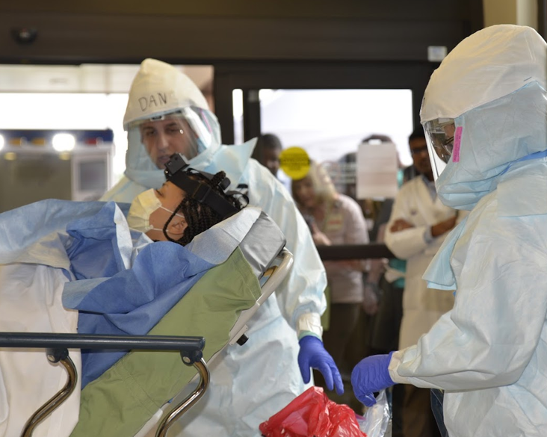
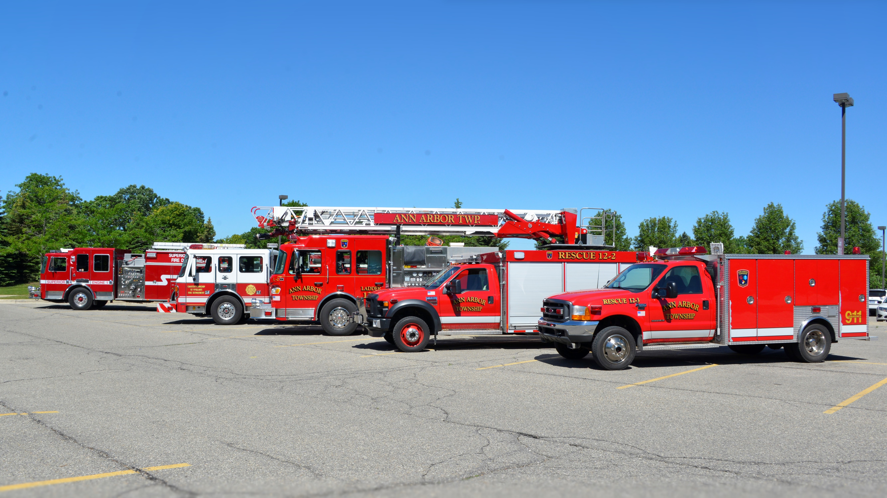
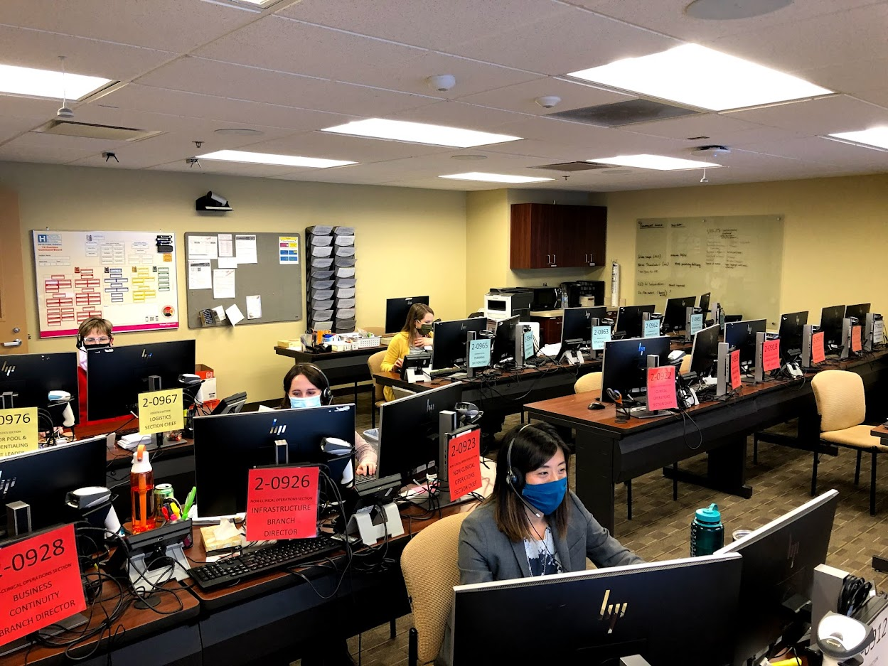
Volunteer Procedures Check in/Check out
Volunteer kiosks are located in the following locations at our hospitals.
Trinity Health Ann Arbor, Chelsea, & Livingston Front Desk/lobby area, Reichert Health Building info desk, Imaging Center hallway, & Ann Arbor emergency department discharge area. Canton & Brighton Health Centers main information desks upon entry.
Refer to your orientation packet on swiping in procedures for Vsys One.
Swipe in using the swiper if available.
Use the mouse to enter your volunteer ID number, located on the back of your badge if there is no swiper.
If the screen is changed, revert back to Zenworks to open up our program and/or hit the windows button.

Slide 17
Volunteer Procedures Dress Code Do’s & Don’ts
Do: Always do the following related to dress code and volunteer policy and expectations.
Wear your name badge and volunteer Trinity blue vest at all times when volunteering.
Don’t: Present for volunteering with any of the following.
No Jeans, capri pants, leggings, sweat pants, shorts, or jogging suits.
No sleeveless or midriff baring tops.
Wear closed toed shoes with hosiery
Final Thoughts…. Patients and families form opinions about our standard of care partially from the appearance of those caring for patients, therefore here are some final tips too.
You are responsible for the cleanliness and neatness of the Trinity volunteer vest.
Be conservative in hair, dress & make-up, with long hair tied back.
Use fragrance-free personal products.
No Sandals of any type, no bare legs
No excessive jewelry, No visible body piercings other than earrings.
No head covering except for religious or medical reasons.
No gum chewing.
The ID badge must be worn at the shoulder level and not be defaced in any way with stickers/pins attached.

Slide 18
Volunteer Procedures: Your Volunteer Liaison
Main contact person for the unit or dept. where you are assigned.
The person in charge of you and responsible for your specific orientation and training(although you may report weekly to other staff).
Please inform your liaison when you will be out of town, sick, or decide to discontinue volunteering.
Illness: If you are not feeling well, you should stay home and contact your liaison to let them know you will not be in on that day.
Attendance: Be punctual and regular in attendance but if you are unable to make a shift you should let your liaison know ahead of time. Meet commitment 4 hour &/or 6 -month annual serving requirement.
Accident on Duty: If you witness an accident or are injured yourself report to your department liaison immediately. An incident report will need to be completed.

Slide 19

Termination of your volunteer service:
Return your badge and uniform.
Inform your liaison that you will not be volunteering anymore, including the last day.
Inform Volunteer Services you will not be volunteering anymore.

Slide 20
Infection Control:

Slide 21
Hand washing is the single most effective way to prevent the spread of infection.
Hands must be washed:
On arrival to volunteer
Before leaving the restroom
Before and after eating
After removing gloves
Between handling of patients
After using the toilet, after blowing or wiping the nose
Before leaving the hospital

Slide 22
Plain Language Review

Slide 23
Plain Language
Hospitals use plain language for emergencies
The only color code is CODE BLUE
Event | Overhead Announcement "Your attention please..."
Disaster | "[Ministry] is responding to a(n) [specific] disaster. More information to follow."
Fire Alarm | "There is a fire alarm activation in[floor/unit/department]"
Code Blue | "There is a Code Blue in [floor/unit]"
Medical Emergency | "There is a medical emergency on [floor/unit/dept]"
Rapid Response | "There is a rapid response needed in [floor/unit]"
Severe Weather Event | "There is a [severe weather event] [watch/warning] in effect until [time]"
Missing infant or child and description | "There is a missing [child/infant]. [Description]"
Missing patient and description | "There is a missing patient. [Description]."
Security assistance required and location | "Security assistance is required in [location]"
Active Shooter and location | "There is an active shooter in [location]"

Slide 24
What to do in a Fire Alarm Activation
At Fire Scene, use R.A.C.E. to guide your actions:
  Rescue
  Alarm
  Close doors
  Extinguish / Evacuate
Also be sure to:
  Reassure patients
  Close doors
  Clear hallways

Slide 25
In a Fire Alarm Activation
DO NOT use elevators
MOVE EQUIPMENT on wheels in the hallways to one side (or to alcoves)
Make sure exits, extinguishers, and fire pull stations are not blocked
Remember: Never store items above 18’’ from the sprinkler head or below ceilings in rooms without sprinklers

Slide 26
Code Blue
If you find someone UNCONSCIOUS / UNRESPONSIVE:
  Notify the Regional Call Center
      Utilize Code Blue button on phone, if applicable
Begin CPR if needed and if qualified
Obtain / Utilize AED if available
Remain until help arrives (team or ambulance)

Slide 27
Medical Emergency
If you find someone CONSCIOUS and RESPONSIVE (i.e., fall, hypoglycemia episode, seizure):
  Notify the Regional Call Center
  Remain until help arrives (dependent on location)
  If their status changes, update Regional Call Center

Slide 28
Missing Patient
If you are unable to find a patient, notify regional call center and ask the operator to initiate a “Missing Patient” and provide unit location and appropriate description.
  ALL Staff: Monitor all exit locations, stairwells and elevators for persons who look lost or confused and are attempting to exit the building wearing a patient gown, street clothes, or have on a patient identification armband or bandages.
  If staff suspect they have found the patient, ask the patient their name and if they can help return them to their room. Contact security and provide their location.
If the patient is at all hostile or aggressive, notify security and do not attempt to physically stop the individual.
  If the patient does leave, note helpful information: vehicle license plate, type of vehicle, direction of travel, description of person they are with, etc.
  Document the episode in the EMR and VOICE.
Behavioral Medicine Unit, Chemical Dependency Unit, and Birthing Center have locked doors and restricted access onto the unit.
  Do not open the unit doors for anyone, even if they have a badge. Unit staff will assist visitors and determine appropriate access to the unit.
  When exiting the unit, check for patients in the hallway. If there is a patient nearby, press the intercom button and ask staff to redirect patients away from the door area before you open the door.
  Check to make sure the door closes behind you. The door will make a click sound when lock-reactivates.

Slide 29
Weather-Related Threats
When a weather-related threat occurs, you will hear:
"There is a [severe weather] [watch/warning] is in effect until [time]”
Patient Care Areas:
      Close the drapes/shades
      Check on and reassure patients
      Follow your departments severe weather plans
Non-Patient Care Areas:
      Close the drapes/shades
      Go to inner hallways away from windows
Listen For Updates

Slide 30
Security Assistance Required
You may need to act if you are concerned that a situation may escalate to a threat of harm or violence.
If you or others are in IMMEDIATE DANGER
      Move those in danger to safety
      Notify Regional Call Center that Security Assistance is needed (give location/description)

Slide 31
Other Threats
Notify regional call center and give specific details to the operator
Overhead announcements and instructions will be provided when appropriate
Disaster Response (Hospital Incident Command) will be activated as needed
Evacuate only if instructed to do so

Slide 32
Evacuation & Sheltering-in-place

Slide 33
Types of Evacuation
Horizontal Evacuation: This level of evacuation involves moving patients who are in immediate danger away from the threat. Patients remain on the same floor of the hospital as the area that they are evacuating. Horizontal evacuation typically involves moving patients to an area of refuge in an adjacent smoke/fire zone or in some cases, at the opposite side of the building. Most evacuations of a single department or patient care unit can be done horizontally, which is the fastest option and has the simplest re-entry process. Evacuation of an entire building may even be accomplished horizontally if every floor of the evacuated building connects to another building.
Vertical Evacuation: This level of evacuation refers to the complete evacuation of a specific floor in a building. In general, patients and staff evacuate vertically towards ground level whenever possible. Moving patients and staff to lower levels helps to prepare for total or full evacuation of the facility should the situation worsen. For most localized incidents, vertically evacuated patients and staff are sent to an area of refuge elsewhere in the hospital typically at least two floors away from the incident floor. During the vertical evacuation of one floor, other floors may be ordered to shelter-in-place or prepare only for their own evacuation.
Total or Full Evacuation: This level of evacuation is used only as a last resort and involves a complete evacuation of the facility. There are many different ways that a total or full evacuation can be planned for and managed.

Slide 34
Shelter-in-place
This level of evacuation requires ending all routine activities in preparation for an impending threat, such as a tornado or toxic cloud. Specific preparations should be made to mitigate against the anticipated threat.
In general, during a no-notice event, patients, visitors and staff remain where they are until they receive further instructions.
Closing doors/windows provides initial protection from fire, smoke, and other hazards.
During a shelter-in-place response, preparations should also be taken to enable immediate evacuation of patients should the situation change, and evacuation become necessary.

Slide 35
Staff Response and Notification
Depending on the threat, staff may need to stay in place or initiate evacuation out of the affected area.
  Hospital staff facing imminent danger from outside sources should stay in place.
  Hospital staff facing imminent danger from smoke, fire or infrastructure damage, should move out of the immediate area.
In both instances, staff need to report the emergency immediately. Inform area leadership of the event requiring sheltering in place or evacuation and activate the incident command alert (ICA).

Slide 36
Patient & Protected Health Information
In the event of an emergency/disaster or evacuation, the method for sharing and/or releasing location information and medical documentation for patients under the hospital’s care are consistent with requirements of law or regulation.
Policy links below address disclosure of protected health information to the following individuals or entities:
  Patient’s family, representative, or others involved in the care of the patient
  Disaster relief organizations and relevant authorities
  Other health care providers
ICP.3 Use and Disclosure of Protected Health Information
ICP.11 Individual Rights Regarding Restrictions and Confidential Communications
ICP.16 Verification of Individuals Requesting Access or Disclosure of PHI

Slide 37
Evacuation Equipment

Slide 38
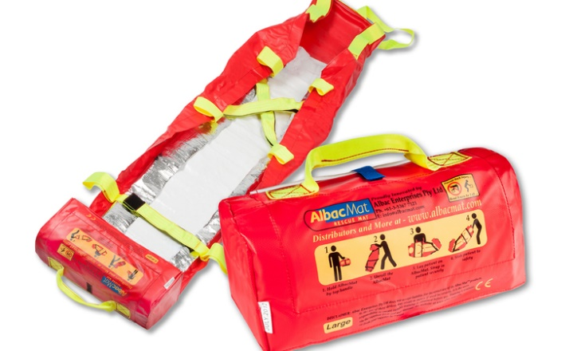
SJMHS: AlbacMat Rescue Mat Training Module
Evacuation Device for Non-Ambulatory Patients
Requiring Vertical Evacuation
At the conclusion of this module, you will be able to:
Verbalize when to use the AlbacMat vertical evacuation mat
Demonstrate how to employ the mat
How to clean the mat after use

Slide 39
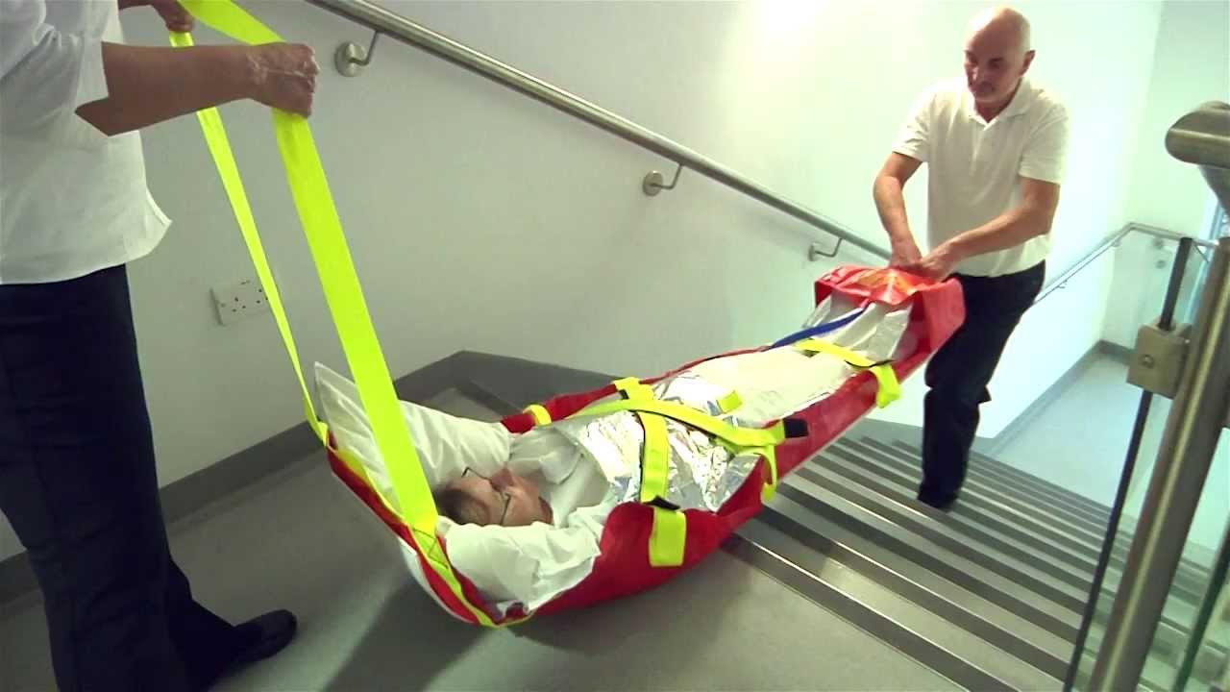
AlbacMat
In an emergency situation, unit leadership in collaboration with Incident Command when appropriate, will assess risk to patient safety and activate the appropriate level of evacuation for the situation when an immediate threat is apparent.
If a threat cannot be contained, horizontal evacuation is the first stage of evacuation. This may require movement of some patients beyond hallway fire doors within the unit or movement of patients to the ‘sister unit’ on the same level when available. If it is determined that a vertical evacuation is necessary, evacuation of non-ambulatory patients down stairways will be required.
The AlbacMat rescue mat is designed specifically for transporting the non-ambulatory patient during a vertical evacuation.

Slide 40
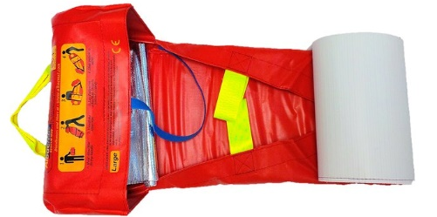
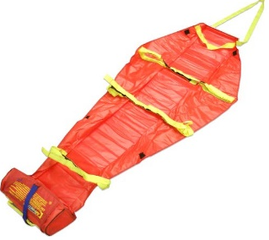
AlbacMat Features
Flexible stretcher that includes:
  Polypropylene flexible base board bottom that glides smoothly over most interior and exterior surfaces, provides insulation to protect the patient and helps absorb impact from rough terrain
  3 fluorescent yellow Velcro cross straps to secure the patient and provide detection in dim lighting
  Pulling handle at the head end and positioning handle at foot end
  Carry handles, 3 on each side for 6-8 person assist if required
  Foot rest pocket for comfort and security of patient within device
AlbacMat is self-contained in its own storage bag weighing (~4½ lbs.)
The bag portion of the mat becomes the foot pocket when in use
Mats accommodate 1000 lbs. Large mats should not be used
for bariatric patients due to their smaller size.
Simple instructions clearly visible on self-storage pocket

Slide 41
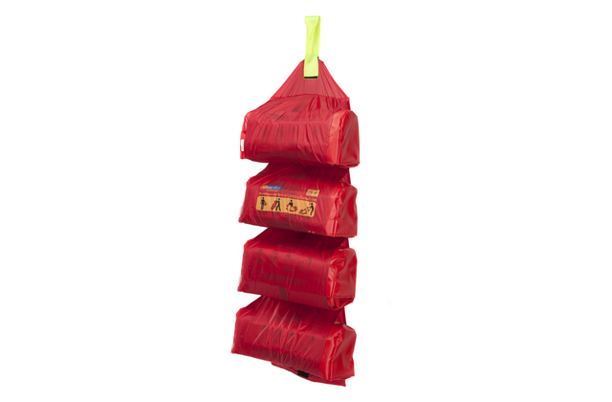
Storage Locations
For Ann Arbor, Mats will be stored on each patient floor, 2-11, in the Equipment Alcoves. No mats are required for 1E due to direct access to the outside.
Each Equipment Alcove will have a sign posted at the hallway entrance to indicate AlbacMats are stored within.
If space allows, AlbacMats will be stored in red soft hanging holders that neatly store 4 mats. If space is limited, mats will be placed on equipment shelves within the alcove.
For Livingston & Brighton, Mats will be stored on patient floors 2 and 3, in the equipment cabinets.
For Chelsea, Mats will be stored on Atrium East, Atrium West, the ICU, and Endo/Pain, in the equipment rooms.
In an emergency evacuation requiring vertical transport of patients, mats will need to go to where the patient needs are. Mats stored on one floor that are not needed by patients on that floor, should be shared with other floors upon request.

Slide 42

Care of the AlbacMat After Use
AlbacMats can be used more than once if there is no structural damage or excessive soiling that cannot be cleaned after use. After use, the AlbacMat should be wiped down with antibacterial wipes.
After Use Cleansing:
Obtain PPE: Gloves (Gown/mask/face shield as needed)
Disinfect all surfaces of the mat using antibacterial wipes:
Gray top for after use by non-isolation patients
Orange top with bleach for after use by isolation patients
Ensure cleaning agent remains wet on the surface for the appropriate contact time:
3 min for Gray top wipes 4 min for Orange top wipes
Dispose of gloves and wipes in the trash
Perform hand hygiene
Mats should dry completely prior to repackaging into their built-in bag and returned to their storage location.

Slide 43
Additional Post Use Facts
If there is excessive soiling of the mat during use, mats can initially be cleaned by hosing off the mat with water or thoroughly wiping mat clean with a damp cloth.
  Next, towel dry mat to remove the excess water
  Allow mat to completely air dry
  Use antibacterial wipes to do final cleansing of mat. Use of undiluted chemicals is not recommended.
Do not roll up and store the AlbacMat until it is completely dry.
Visually check the mat after each use or washing. Check the stitching, Velcro straps, base board (bottom) and pulling handles. If any damage has occurred the AlbacMat should be replaced.
If bodily fluids have leaked onto the webbing straps and cannot be removed, it is recommended that the AlbacMat be replaced to prevent cross-contamination during future use.

Slide 44
Using the AlbacMat
View the video demonstration of how to set up and properly deploy the AlbacMat
Need link Video Training

Slide 45
Find out More

Slide 46
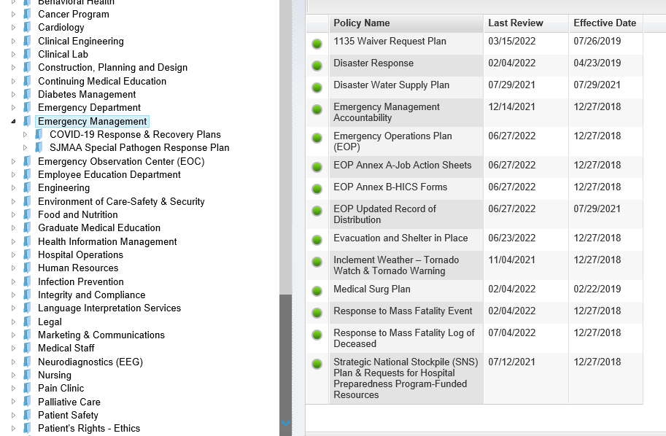
Where do I find Emergency Management Plans?
All emergency management plans, policies, and procedures can be found in Policy Manager under Emergency Management

Slide 47
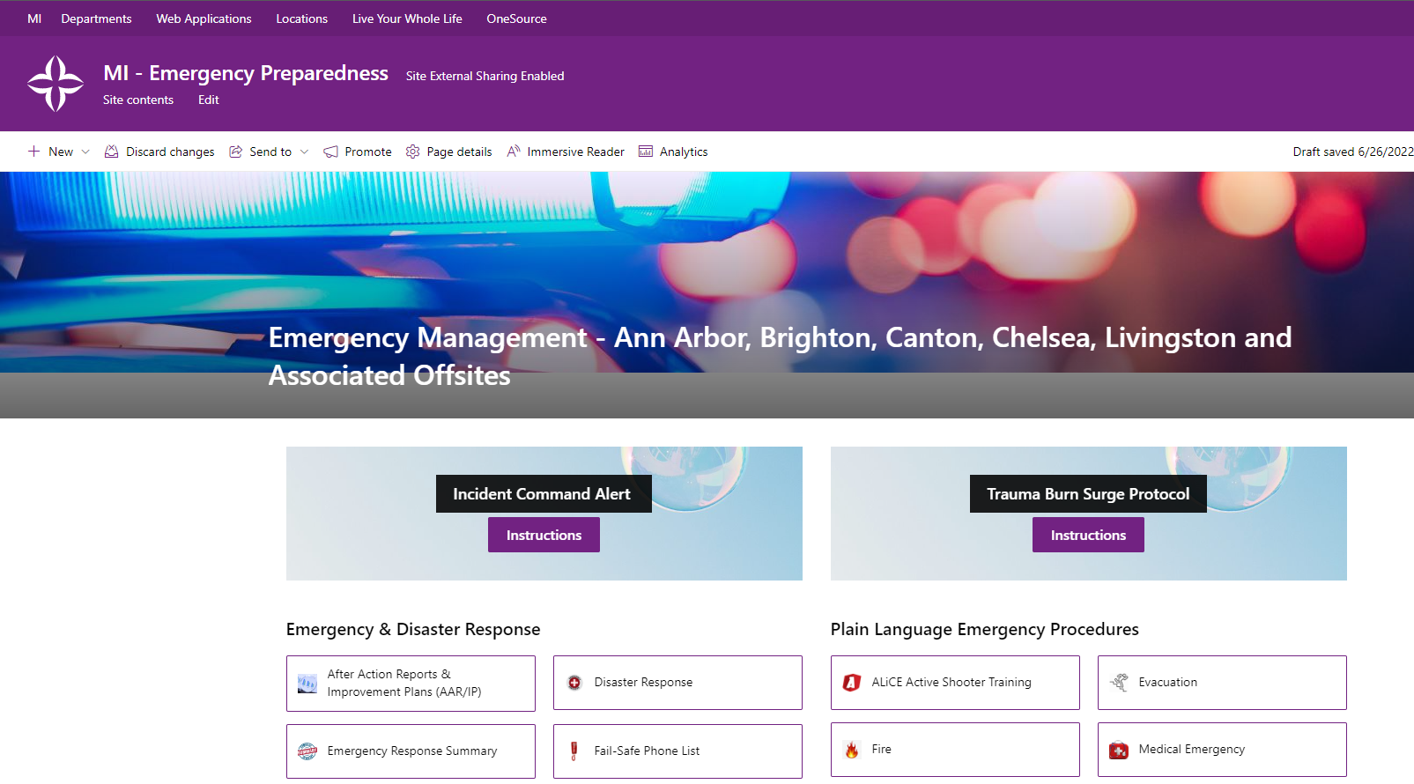
Where can I find out more about Emergency Management?
Emergency Management - Ann Arbor, Brighton, Canton, Chelsea, Livingston and Associated Offsites

Slide 48
Emergency Management Contacts
Denise Bechard, Manager, Emergency Management, Denise.Bechard@trinity-health.org
Jacquelyn Smith, Emergency Management Coordinator, Jacquelyn.Smith@trinity-health.org

