Slide 1

Colon and Rectal Surgery
Enhanced Recovery
A Guide for Patients and Family
Megan Ronayne, BSN, RN

Slide 2
Before Surgery
At your pre-admission appointment you will receive printed instructions about your medications
If you do not have a PAT appointment you will receive a phone call 5-7 days before your surgery
You will receive a phone call the day before your surgery between 1 pm and 6 pm to tell you your surgery time
Should you become ill before your surgery please call your surgeons office 734-712-8150

Slide 3

Twistle

Slide 4
Twistle
A safe/secure app for your smart phone or tablet
Your healthcare team will send you reminders, education, messages and health surveys
You will be sent an invitation on your smart phone to participate, you can then download the app
Messages start 12 days before surgery and continue for 30 days after you get home
Twistle is not for use in an emergency or urgent situation

Slide 5
Twistle
To sign up for Twistle please contact:
Amanda Rothman, ERP assistant - 734-712-2497
Or
Megan Ronayne, Nurse Navigator – 734-712-8438

Slide 6
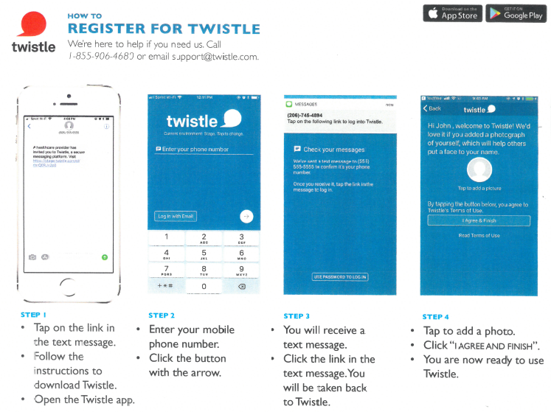
Instructions for downloading Twistle App

Slide 7
Shopping List
3 Bottles of Ensure Pre-Surgery
8 oz jar of Miralax
4 Dulcolax tablets
64 oz. Gatorade
Stop at your pharmacy for prescribed medications

Slide 8

Ensure Pre-Surgery
Ensure Pre-Surgery clear nutrition drink is a carbohydrate rich beverage with added supplements.
Use of Ensure Pre-Surgery Improves
Comfort
Hydration
Hunger
Thirst

Slide 9
Ensure Pre-Surgery
Ensure Pre-Surgery is available for purchase at the pharmacy in the Reichert Medical Center or Joe’s Java at the Main Hospital
You will need to purchase 3 bottles
You need to ask for the Ensure Pre-Surgery at the pharmacy counter in the Reichert Building
This is not for use by Type 1 diabetic patients or anyone on insulin

Slide 10
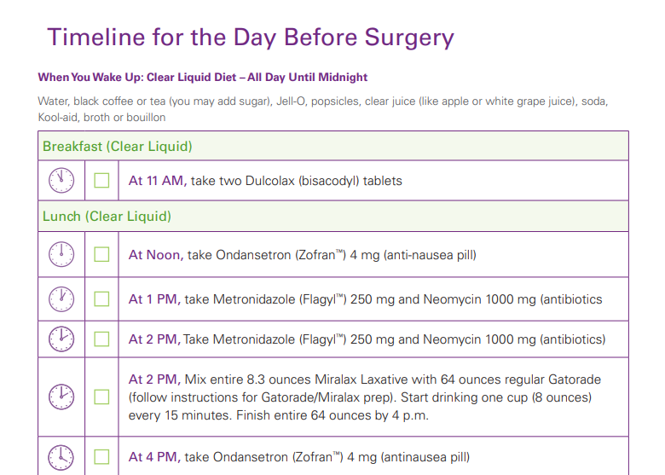
Timeline for Prep Before Surgery

Slide 11
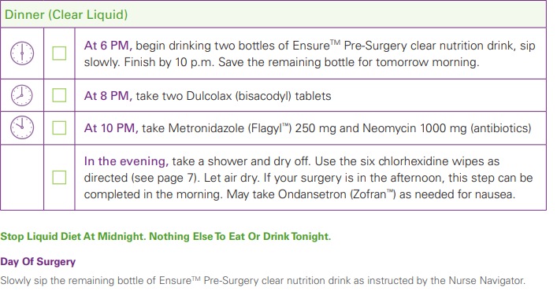
Timeline continued

Slide 12
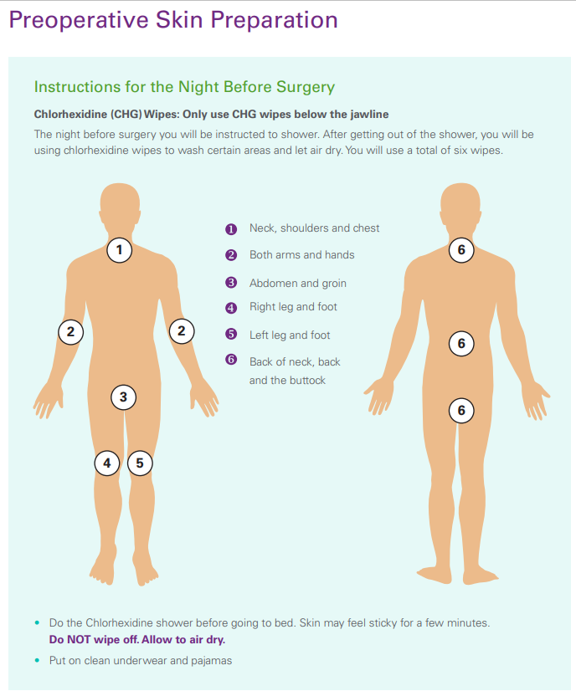
Skin Preparation Before Surgery

Slide 13
Things you can do before surgery
Increase activity
Deep breathing exercises
Improve nutritional status
Stop smoking
De-stress

Slide 14
Hospital Stay

Slide 15
Surgery Day
Drink your last Ensure Pre-Surgery as instructed
Park in parking lot B and go to the main entrance and you will be directed to the pre-op holding area

Slide 16
What to Bring with You
Driver’s license/photo identification
Medical insurance card
Copy of Living Will or Durable Power of Attorney for Health Care
If you use a CPAP machine at home bring it with you, we have distilled water in the hospital for you to use
Cell phone and charger

Slide 17
Pain and Comfort Options
TAP Block
Oral Pain medications
Goals of pain management are for you to be comfortable
enough to
Be able to get up and walk in the halls
Cough and deep breath using your incentive spirometer

Slide 18
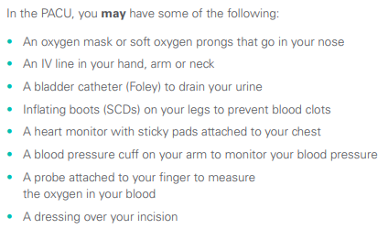
Recovery Room
When you wake up from surgery you may have

Slide 19
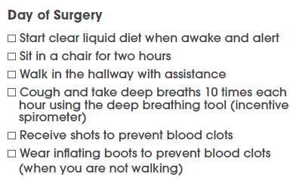
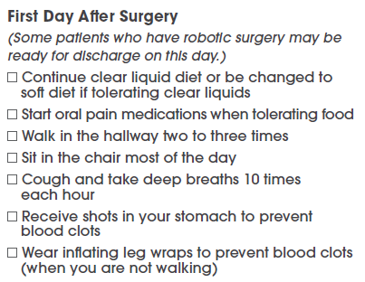
Daily Goals While in the Hospital

Slide 20
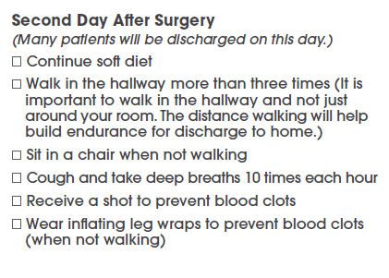
Daily Goals While in the Hospital

Slide 21
What to Expect After Surgery
Bowel Function
Eating
Passing Gas
Wound Care
Incisions need to be washed two times a day

Slide 22
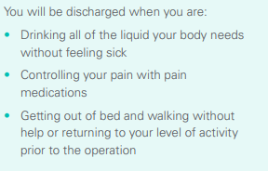
Discharge Goals

Slide 23
Discharge Instructions
Activity
Wound Care
Soft Diet

Slide 24
At Home

Slide 25
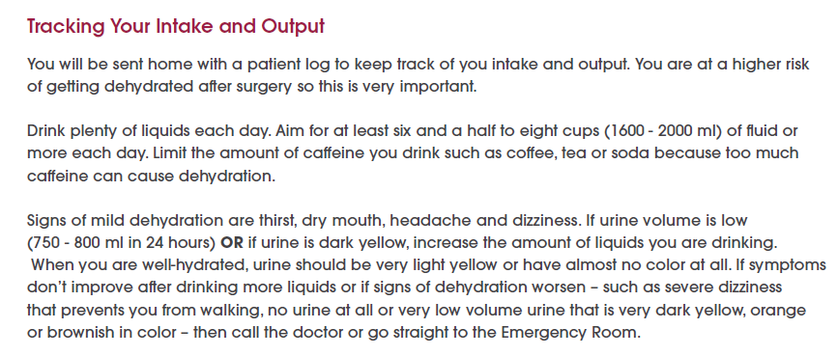
Tracking your intake and output

Slide 26
Recovering at Home
Driving
Medication

Slide 27
Follow-up care
You will have an appointment in with a nurse practitioner in your surgeon's office around 7 days after discharge
You will have a follow-up phone call around 30 days post-op
If you are having problems or concerns call your surgeon’s office at 734-712-8150

Slide 28
When should I call my surgeon?
Contact your surgeon at 734-712-8150 for any of the following symptoms:
 Temperature over 101.5ºF
 Abdomen is bloated
 No bowel movement within four days after discharge
 Bowel movements stop abruptly
 Separation of wound edges, thick green or yellow drainage from the wound or increasing
redness swelling, warmth or pain of the incision
 Severe nausea or vomiting
 Increased abdominal pain that is not relieved by pain medication
 Shortness of breath or chest pain
 Swelling in your legs
 Any other new symptoms

Slide 29
Questions?
If you have any questions about anything you have heard today, or have any concerns please do not hesitate to contact me
Megan - Nurse Navigator 734-712-8438
You can leave a message and I will return your call as soon as possible
If you have urgent questions please call your surgeons office 734-712-8150

